Slide 1
How to get started in Open Source!
Pradeep Singh
mail@pradeepsingh.co.in / @pradeep_sinngh

Slide 2
( Goals of the talk ) #outline

Slide 3
( About Me )
www.pradeepsingh.co.in
mail@pradeepsingh.co.in / @pradeep_sinngh

Slide 4
How I got involved in Open Source!

Slide 5
Part I. (2011)
Discovering Firefox,
And my first contribution!

Slide 6

Revolutionary Web Browser

Slide 7
Part II. (2012)
IRC
Internet Relay Chat is an application layer
protocol that facilitates transfer of messages in the
form of text. The chat process works on a
client/server model of networking.
Some popular channels : #womoz, #remo, #mdn

Slide 8
Part III. (2013-2014)
Started promoting Open
Source, which resulted into
“Open Source Developer Group Mumbai”.

Slide 9
What is Open Source ?!?!

Slide 10
To use, share, adapt, modify and collaborate.

Slide 11
It does not mean…. “free of cost, cheap piece of software, hardware, product or project etc.”

Slide 12
#free here is #freedom not #free. Open Source gives you certain freedom and rights, it doesn’t means you can just use it for free.

Slide 13
Every free Software is not Open Source. Every Open Source Software is not free. Some software are Open Source as well as free.

Slide 14
Open Source is not limited to Software.
Anything and Everything can be Open Source.
Anything here means, anything!
For eg :- Hardware, Cooking Recipes, Books etc.

Slide 15
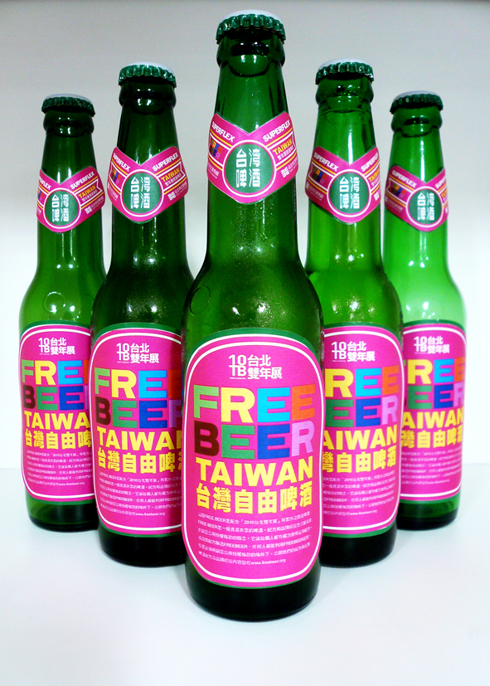
Open Source Beer : Free Beer

Slide 16
Free Beer
Free Beer is an Open Source Beer.
"Free as in free speech“.
It’s formula is available under Common Creative License.
Common Creative License is an famous Open Source License.
It’s name is free because it grants certain freedom and rights.
Free here does not means that you can just pick it up from some store without paying!

Slide 17
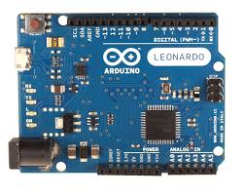
Arduino : Open Source Hardware

Slide 18
Why Open Source ?

Slide 19
Making Linux GPL'd was definitely the best thing I ever did.- Linus Torvalds
FOSS potentially saves industry over 36% in software R&D investment that further can result in increased profits or be more usefully spent in further innovation.
No code is good code,there is always scope for improvement and human limit may restrict the growth of your project,so open the source.
To make your code world class.
Open source software projects may offer a learning opportunity those students aren’t getting in school.

Slide 20

Who is
doing it?
5

Slide 21
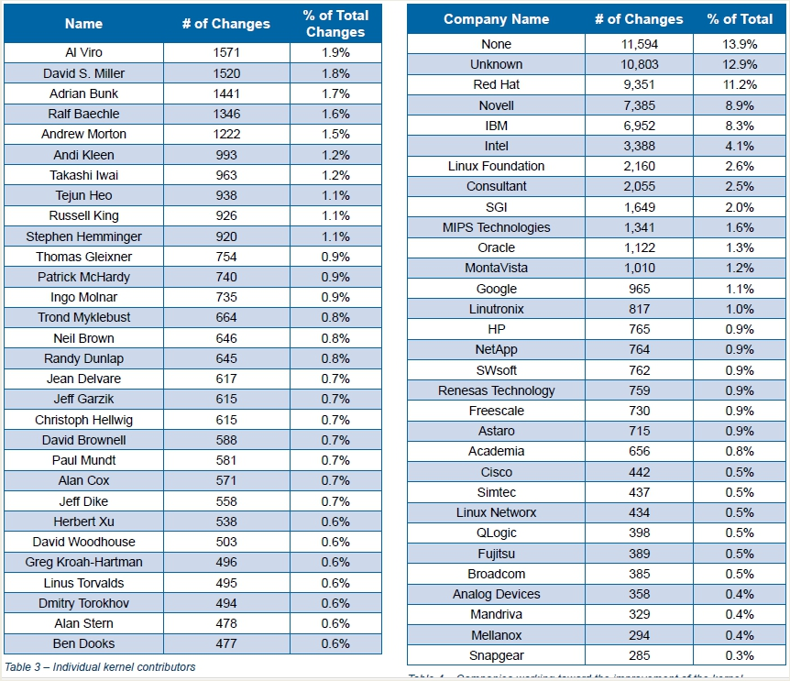
6

Slide 22
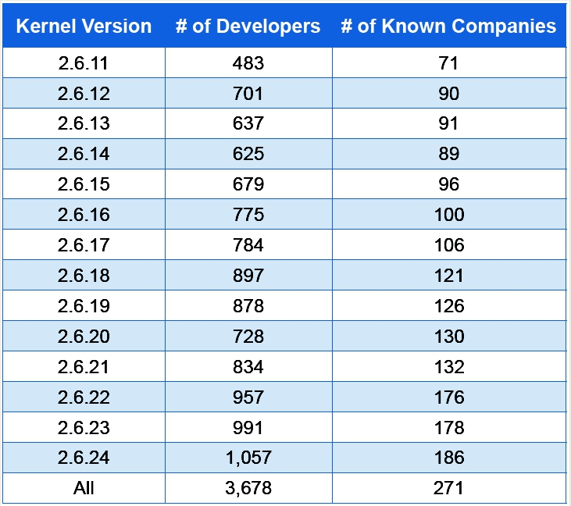
7

Slide 23
Why they contribute?
Companies like IBM, Intel, HP,etc.-- to ensure that Linux runs well on their hardware.
Distributors like Red Hat, CentOS, Ubuntu have a clear interest in making Linux as capable as it can be.
Companies like Sony, Nokia, & Samsung ship Linux as a component of products like video cameras, television sets, and mobile telephones.
VMWare - built on Linux kernel.
NVidia – Interested in Graphics business.
Intel – Processor family interest
Google, Facebook, Yahoo, Microsoft – Runs many Linux based servers in house.

Slide 24
What do I get as a student out of it?

Slide 25
You get : ☺
Chance to interact with world class software team.
Chance to modify or improve world class source code.
Come out with better skills than students who only do the required class work.
Learn from professionals.
Build your resume stronger.
Learn project management.
Learn ins and out of Source code.

Slide 26
How to Get Started!
Choose your area of Network.
Do your homework – mailing list, wiki, code repository; things done in the past, things discussed on mailing list.
“Be familiar with coding style, contribution practices, community email etiquette, and copyright assignment practices for the project you are contributing to.”
“Don't be discouraged by strong personalities in the community and try to understand other people’s perspectives.”
Most of all, Have fun! ☺

Slide 27
Contd…
Reviewing code -- any competent developer appreciates more eyes on the code.
ASK questions!
Documentation as a comments inside source code.
Don’t forget to understand licensing.

Slide 28
Can Open Source be used as Business Model? ( any idea! )

Slide 29

Yes, it can be used. In fact, its been used by some of the biggies.

Slide 30
Business Models :
Open source product’s can be sold and used commercially.
Donations?
Saas? Iaas?
Though there are FOSS apps around developed by big companies,Open source does not always means free of cost.
You can charge/sell your software along with source code.
You can distribute it free and charge for Support.
Important: First understand the Licensing in depth and then go with business.

Slide 31
Few eg :-
Canonical Ltd. offers Ubuntu for free, while they sell commercial technical support contracts.
Mozilla Foundation have a partnership with Google and other companies which provides revenue for inclusion of search engines in Mozilla Firefox.
MySQL is offered for free, but with the enterprise version includes support and additional features.
Red Hat offers the Fedora for free through the Fedora Project, while selling Red Hat Enterprise Linux (RHEL).
Oracle offers OpenOffice.org for free, while selling StarOffice.

Slide 32

Prodigies?

Slide 33
Examples contd…
Zend Technologies offers Zend Server CE and Zend Framework for free, but sells Zend Server with support and additional features.
Wikipedia – Runs of donations.Sharing what we know for free.
KQInfotech's ZFS port to Linux
Infibeam?

Slide 34
So do you…
..use good quality FOSS every day?
..like the freedom and openness of the Internet?
..think that Internet content should remain free?
..share stuff with your friends for free?
But
Did you know that all (a lot) of this stuff is based on...
Open Source!

Slide 35
Opportunities in India…?
Ever growing market.
Indian government is going to create business opportunity worth billons of dollars. (Yes, I am serious :P)
Web 2.0 or 3.0 – ever growing online business. Semantic Web is the next big thing.
With players like Mozilla, Web is becoming more and more open day by day.
Education.
Services. Hosted Services.

Slide 36
HotTech Trends Today (Off course with the help of Open Source tools)
Android
Chrome OS (Google)
Python (the next java ☺ )
Amazon cloud solutions
Virtualization
Drop Box

Slide 37
What are the ways to contribute?
Coding :- Write codes
Localization :- Act of Localizing.
Bugs :- Fix and report bugs.
Documentation :- Write Reports and Documents to support the product.
Testing and Quality Assurance :- Test the product and help enhancing the quality.
Visual Design :- Design the product.
Evangelism :- Promote the product or project.

Slide 38
Different Open Source Projects
There are thousands of Open Source Projects available, out of which some of the most famous projects are :
Fedora Project
Mozilla Project
Ubuntu
Wikipedia
Chromium OS
Android
KDE

Slide 39
Gnome
Drupal
Arduino
Apache
Moodle
Joomla
Python
Speed Dreams
Wordpress

Slide 40
Well, that’s definitely not all as the open source world is a vast one. Here is a list of open source project repositories where you can find work on many small and big open source projects looking for help:-
Github
SourceForge
Google Code
Bitbucket
CodePlex
Open Hatch
Gamedev

Slide 41
Linux Kernel
Choose an area of the kernel of your interest.
Do your homework -- mailing list(s), a wiki,code repository;things done in the past,things discussed on mailing list.
"Be familiar with coding style,contribution practices,community email etiquette,and copyright assignment practices for the project you are contributing to.“
Don't be discouraged by strong personalities in the community and try to understand other people’s perspectives.“
Testing kernel for different QA tests.
Reviewing code -- any competent developer appreciates more eyes on the code.

Slide 42
Documentation as a comments inside source code
Submitting patches.
And you know what? It never ends …
“And most of all, Have fun!” ☺

Slide 43
Linux Kernel useful links-
Mailing List :-
The Linux Kernel Archives http://kernel.org/
The Linux kernel mailing list archive https://lkml.org/
Subscriptions http://www.tux.org/lkml/
Other important links
Linux foundation http://www.linuxfoundation.org/
Linux kernel interactive map http://wwwma. elinkxu.net/kernel_map
Kernel documentation http://kernel.org/doc/
Linux Kernel Newbie's http://kernelnewbies.org/

Slide 44
Ubuntu
Development
Write and package new software or fix bugs in existing software. Your technical skills can make a real difference.
Design
Put your creativity to work by improving the look and feel of Ubuntu. Help design graphics, backgrounds or themes for the next release.
Bug squad
Help make Ubuntu even better by working with bug reports to ensure they're clear, complete and easy to reproduce. Anyone can help!
Documentation
Help produce official documentation, share the solution to a problem ,or check, proof and test other documents for accuracy.

Slide 45
Ubuntu contd…
Support
Share your technical know-how with other users by joining email and discussion lists or Internet relay chat (IRC) channels.
Testing
Ubuntu releases new versions every six months so we need lots of testers who can report or confirm problems.
Ubuntu Brainstorm
Everyone can participate in the Brainstorm website. It's full of ideas on how to improve Ubuntu.
http://brainstorm.ubuntu.com/

Slide 46
Wikipedia-
Among top five most visited website.
Runs on donations and contributions from around world.
Everyone should contribute because it’s cool to share your knowledge.
And it’s a lot of fun.
Most friendly open source project!
Helps you to become good at writing world class articles.

Slide 47
How to ?
Create an account
Learn some basic markup syntax and go. It’s that simple.
What can be contributed ?
Articles, Images, Audio, modifications to existing articles.
Participate in talk pages, it’s a lot of fun.

Slide 48
Chromium OS
An open-source operating system built on top of linux kernel.
Built on concept of cloud for people who spend most time on the web.
Anybody can download the build,read/review the source code,modify and submit it back. http://www.chromium.org/chromium-os
Chromium OS Developer Guide
http://www.chromium.org/chromium-os/developer-guide
A best place to participate in next big thing!

Slide 49
Mozilla
Mozilla foundation hosts many cool and successful projects.
Firefox is one of the most downloaded software on earth.
Contribution opportunities:
Localization
Testing and QualityAssurance
Coding
Visual Design
http://www.mozilla.org/contribute/

Slide 50
Fedora
Fedora Easy Fix Page : All the easy fixes you can get started with
Link - http://fedoraproject.org/easyfix/
Fedora Infrastructure repositories contain some easy fixes. Look for the EasyFix label in the repository issues section.
Link - https://github.com/fedora-infra

Slide 51
KDE
If you want to start contributing to KDE, look out for the Junior Jobs tag. Like each organization KDE too contains a section on how to get started with the KDE projects.
Getting Started - http://techbase.kde.org/Contribute
Building a KDE Application - http://techbase.kde.org/Getting_Started/Build
KDE Guide for a new contributor - http://flossmanuals.net/kde-guide/
IRC - #kde-devel on Freenode
Mailing List - https://mail.kde.org/mailman/listinfo/kde-devel

Slide 52
OpenStack
OpenStack is also a great project to start with. The OpenStack project is divided into various components: Swift, Glance, Nova, Horizon, Keystone.
OpenStack Wiki Main page- https://wiki.openstack.org/wiki/Main_Page
Each Component page contains the link to repository, bug tracker(Launchpad), Documentation etc. OpenStack call their beginner bugs as "Low Hanging Fruit".
Getting Started - https://wiki.openstack.org/wiki/How_To_Contribute
If you are a developer -https://wiki.openstack.org/wiki/How_To_Contribute#If_you.27re_a_developer
Documentation - docs.openstack.org
IRC - #openstack-101, #openstack on Freenode

Slide 53
Apache
Apache maintains quite a number of projects.
Lists a catalog of more than 140 projects in which one can start contributing.
Link -project.apache.org
The New Comers section is an easy read on how to get started in Apache,
Link -http://community.apache.org/newcomers/index.html
Getting Involved wit Apache Software Foundation
Link - http://www.apache.org/foundation/getinvolved.html

Slide 54
Python
To start with contributing with Python, just head over to the Developer's Guide (http://docs.python.org/devguide/ ).
It starts with cloning the repository in your system tell goes on to tell how can you check for the easy fixes.
The developer guide mentions that how can you start with making documentation fixes, then move up to fix small bugs. Once you get acquainted you can start taking up easy bugs.
READ: http://docs.python.org/devguide/fixingissues.html
Issue Tracker: http://bugs.python.org/
Easy Issues: http://goo.gl/NzJuDp

Slide 55
Once you start contributing, you start interacting to people via IRC, mailing lists.
Go through the etiquette an organization follows.
In general roll your eyes through this presentation to get a brief of it.
Link -http://www.shakthimaan.com/downloads/glv/presentations/mailing-list-etiquette.pdf

Slide 56
Some cool internship and fellowship projects

Slide 57
Shuttleworth Foundation 1 Year Fellowship Program
http://www.shuttleworthfoundation.org/funding/fellowship-programme/
Does not have strictly defined areas of funding.
Suggested areas :-
Communication and Analytical Skills in Education
Intellectual Property Rights
Open and Collaborative Educational Resources
Telecommunications
Open Philanthropy
Open Science
work from where you are!

Slide 58
Internship at the FSF
http://www.fsf.org/volunteer/internships
FSF sponsors the GNU project
Chance to work with team who writes gcc,gdb,emacs and many cool projects.
Work remotely.
Unpaid but value of experience counts.

Slide 59
Google Summer of Code
Offers student developers stipends to write code for various open source software projects.
accepted students are paired with a mentor[s] from the participating projects, thus gaining exposure to real-world software development scenarios and the opportunity for employment in areas related to their academic pursuits.
more source code is created and released for the use and benefit of all.
http://code.google.com/soc/
http://code.google.com/opensource/

Slide 60
Quote :-
You shouldn't become an artist so you can be famous, but because there's art inside of you that will kill you if you don't let it out. You shouldn't found a startup to make money, but because it's your life's work. And you shouldn't hack on open source projects because someone told you that your GitHub profile is your new resume, but because you want to code socially.

Slide 61
Open Source Developer Group Mumbai
Community of Open Source promoters, who are helping students to get into Open Source.
We do lot of stuff.
Open Source Boot Camp, Open Talks (Tech Talks ), Developer Conference, Meetups , Hackathons and Appathons and many more.
We also provide guidance in Projects (Yes, projects has to be Open Source).
And the best part is, What ever we do, we do it for free!
Attend all out events for free. Yes, FREE, FREE, FREE.

Slide 62
Get involved in OSDGM (Open Source Developer Group Mumbai)
What can I do:-
Core Team Member - Work with us
Volunteer - Volunteer for us.
Speaker - Speak for us.
Work from Home – You can also get involved or work for OSDGM from your place.
Designer – Graphic Designer/ Motion Designer.

Slide 63
Procedure :-
Well, there is no procedure.
Yes, no interviews, nothing. If you are interested, that’s more than enough.

Slide 64
Talk to us :-
We do stuff for free. Organize any of our event at your college.
Email :- osdgmumbai@gmail.com
Facebook Page - https://www.facebook.com/OpenSourceDevGroup
Website :- Coming Soon! ☺

Slide 65
Fork my slides here :-
https://speakerdeck.com/pradeep_sinngh/how-to-get-started-in-open-source

Slide 66
Thanks, that’s all from my side. ☺
Still not clear about Open Source? Feel free to reach me.
Pradeep Singh / @pradeep_sinngh
Email - mail@pradeepsingh.co.in | pdeepsingh91@gmail.com
Homepage – www.pradeepsingh.co.in
Contact No - +91 9768314726

